Slide 1
Twitter App
Karun Kesavadas , Rishi Jatania

Slide 2
Agenda
Architecture
Technology Stack
User Actions
Cluster Creation
Monitoring and Alerting

Slide 3
Architecture

Slide 4

Architecture
Our application helps users to share tweets containing tags and images with their followers.
The application comprises of a front-end, middleware, Redis queue and two back-ends.
All requests made by the front-end are handled by the middleware which then communicates with the Redis queue and the two back-ends.
The first back-end handles all the requests for user profile and authentication.
The second back-end handles all requests for tweets.

Slide 5
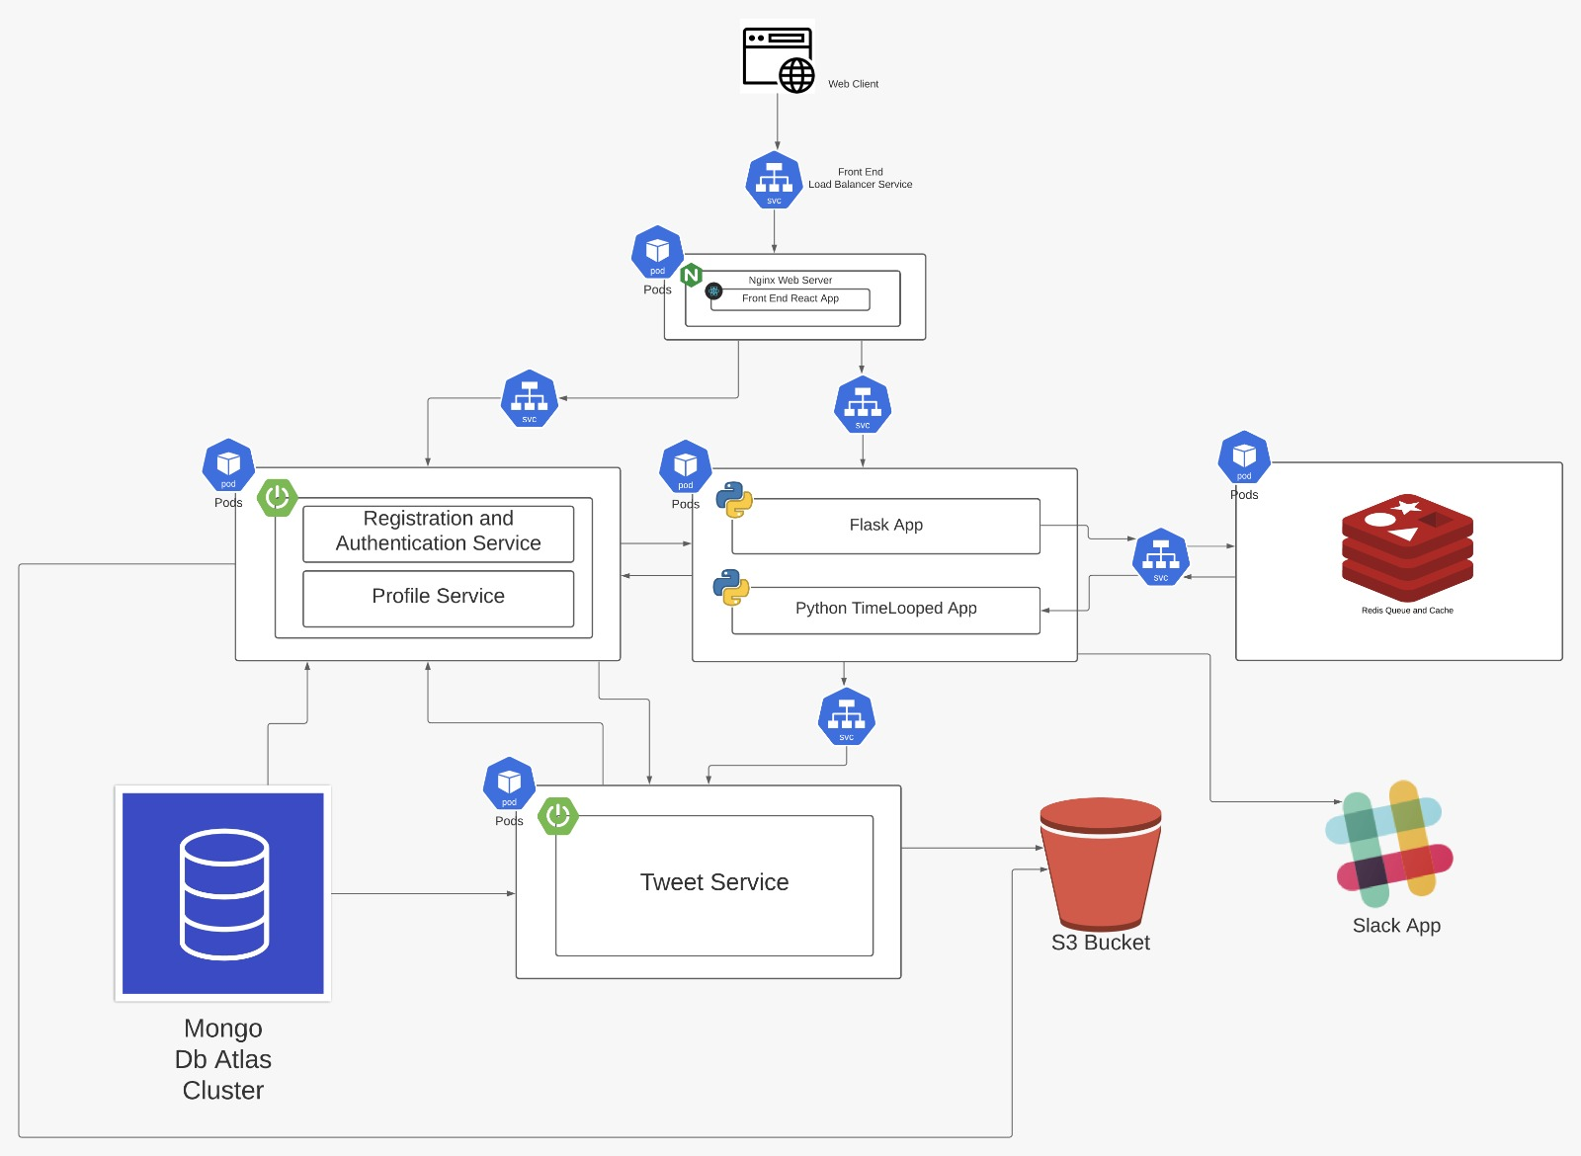
Architecture

Slide 6

Technology Stack

Slide 7
Technology Stack
Used React and Material UI in the front-end.
The middleware consisted of a Python application and Redis JSON queue. Rapid API was used for profanity detection.
Back-ends used Spring boot, Spring Security, Spring Data JPA and AWS Java SDK.
All the user and tweet data is stored in MongoDB Atlas.
All the user profile and tweet images are stored in an s3 Bucket.

Slide 8



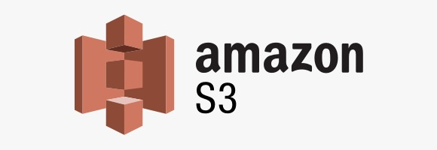

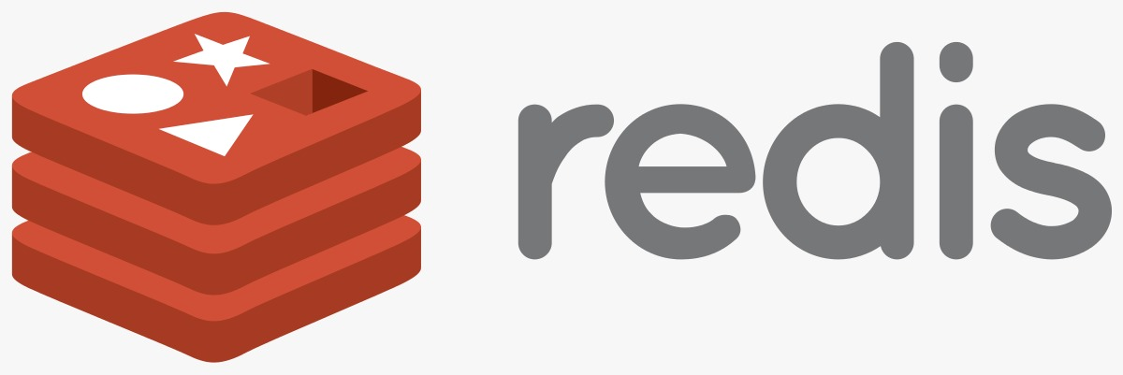
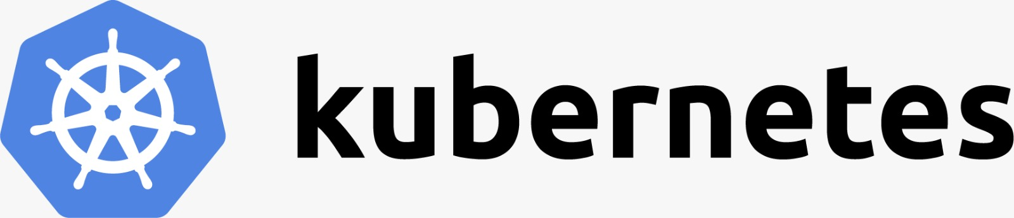

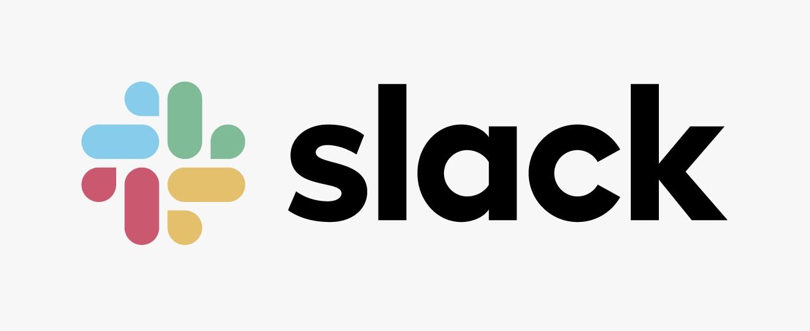
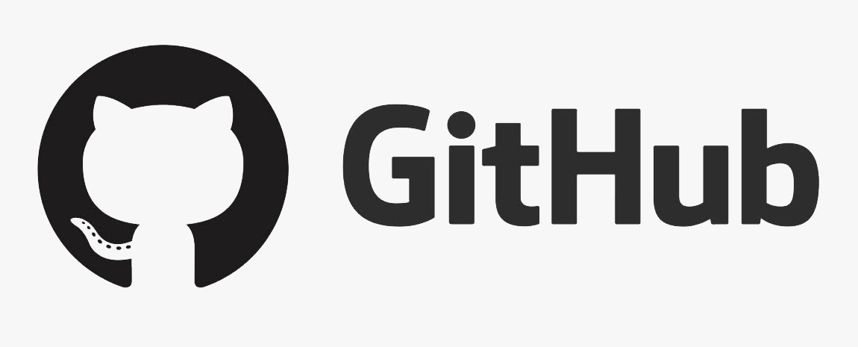
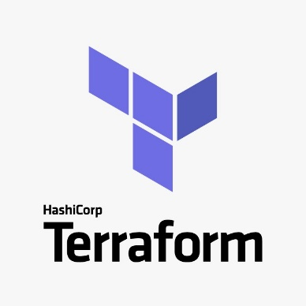
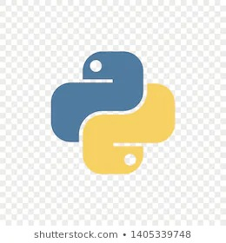





Technology Stack

Slide 9
User Actions

Slide 10
User Actions
Sign up and then sign in to the application
Edit profile
Post tweets with hash tags and images
Search for tweets by text or hash tags
Follow other users
Comment and Like tweets

Slide 11
Cluster Creation

Slide 12
Application Deployment
Github actions creates new Docker images and pushes it to DockerHub.
Terraform was used to bring up an EKS cluster and worker nodes.
Create deployment and services for each microservice.
Deployed Prometheus and Grafana for metrics collection and visualization.
The complete deployment process has been automated using bash scripts.

Slide 13
Thank you!

